Slide 1


LECTURE 2
Labs of Physics for Engineers
Archimedes' Principle
Physics Experiment Teaching Center

Slide 2
Aim:
Measure the density of water
Measure the density of the metallic cylinder

Slide 3
Theory
When an object is partially or completely immersed in a liquid it experiences an upward force (upthrust) equal to the weight of the liquid displaced.
For a cylindrical object：
A: cross-sectional area
h: submerged height

Slide 4
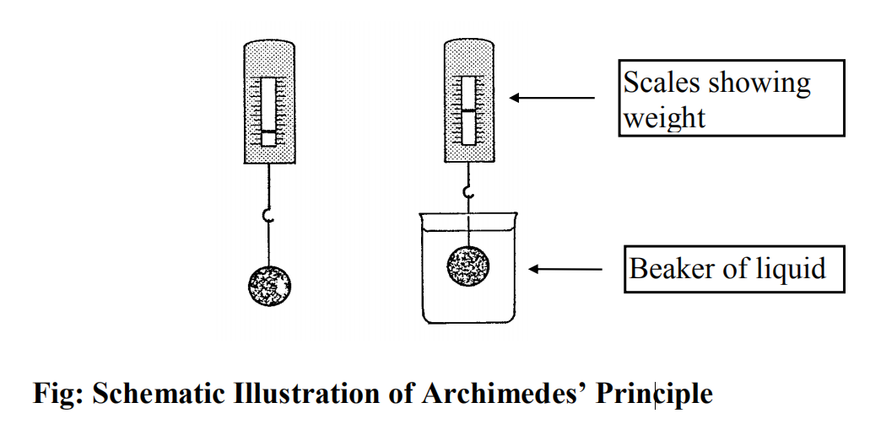
Theory
If an object is weighed in air and then weighed while submerged in a liquid, the object will show an apparent loss in weight
Apparent Loss in Weight = Weight of Liquid Displaced

Slide 5
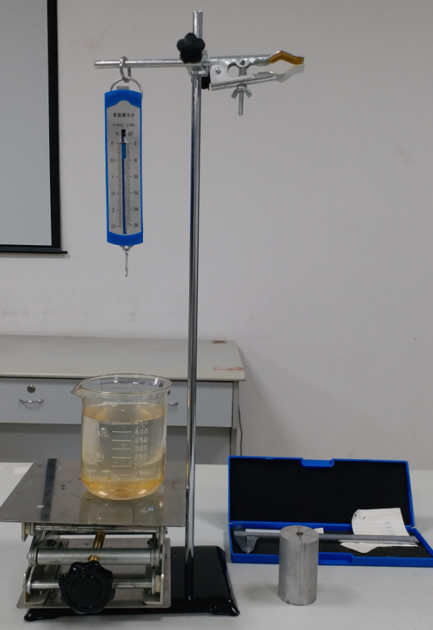
Procedure: Density of water
Measure The density of water using Archimedes’ Principle
Equipmennt：
A force sensor，a Vernier Caliper，a lab jack, a beaker, a test bench, a metallic cylinder with hanging point.

Slide 6
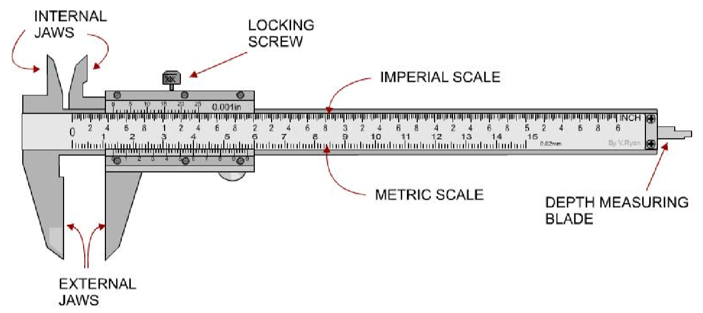
Measure the diameter of the cylinder
Measure the diameter 6 times,change angle and height when measuring.

Slide 7
Vernier calipers
Read and record (in millimetres) the figure on the main scale immediately preceding the zero of the vernier scale (A on diagram).
Move along the vernier scale to locate a division that is directly in line with a division on the main scale. Record the position of this division on the ‘vernier scale’. Each small division of the vernier scale is 0.02mm (B on diagram).

Slide 8
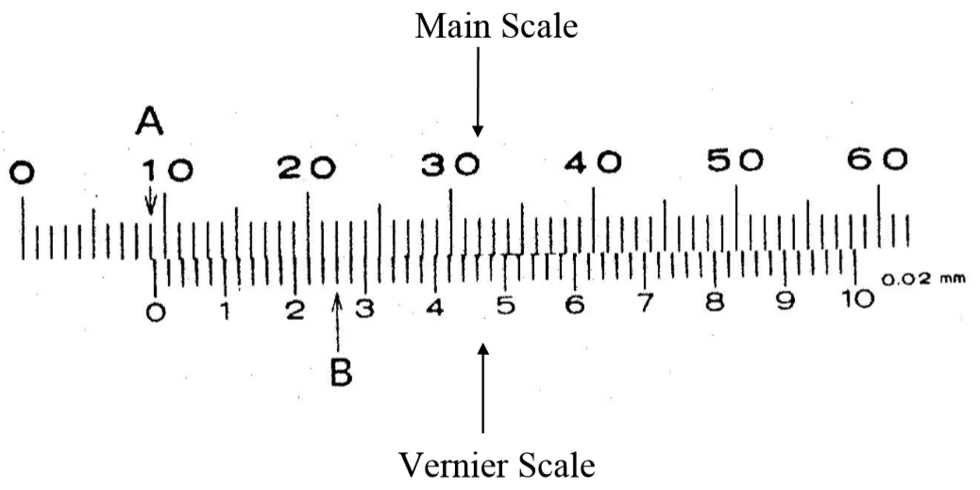
Vernier calipers
Reading A: 9 mm Reading B: 0.26mm Total: 9.26mm

Slide 9
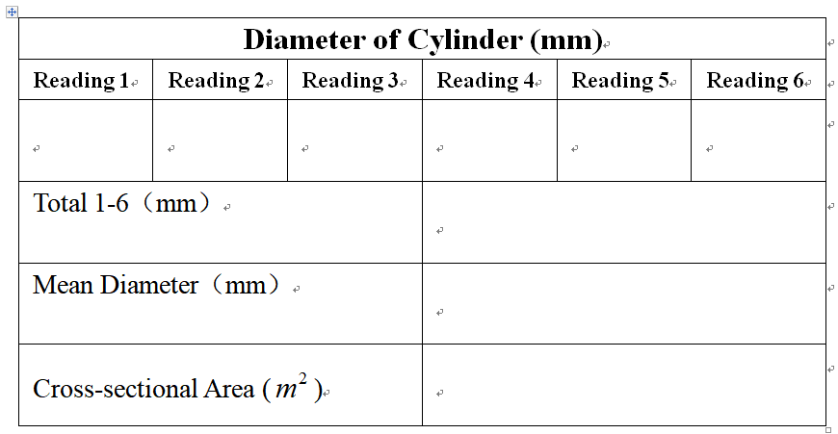
Calculate the cross-sectional area

Slide 10
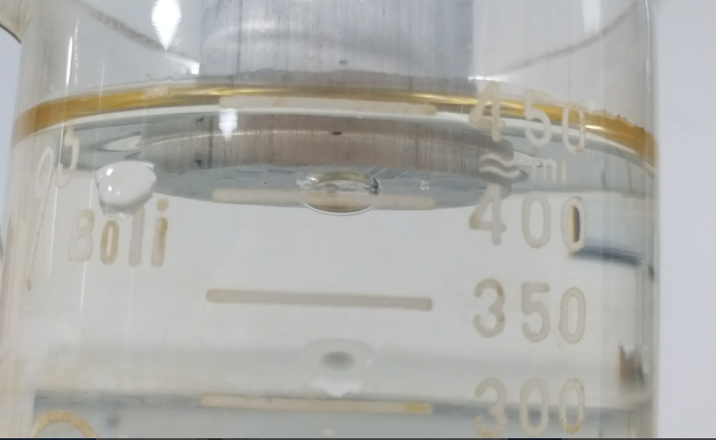
Measure the buoyant force of water
Use the lab jack to raise the beaker until the lowest mark on the side of the cylinder is level with the surface of the water.
After one or two minutes, to allow the system to stabilize, Read the scale on the force sensor and record the force.

Slide 11
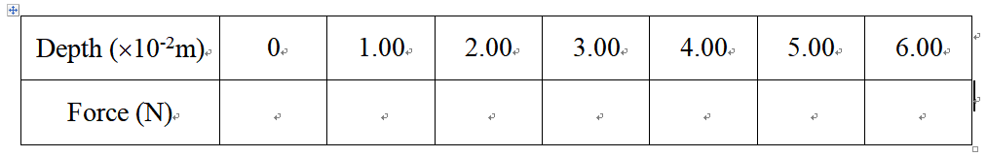
Measure the buoyant force of water
Increase the depth of immersion by steps of 1 cm and record the force at each depth.

Slide 12
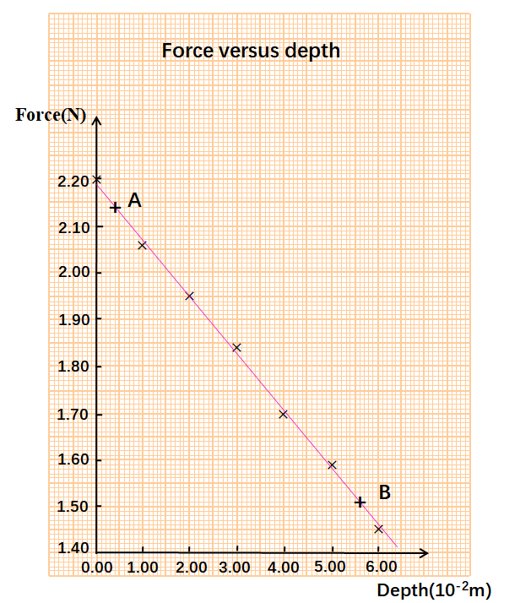
Density of water
Plot a graph of force versus depth of immersion.
Choose two points from the graph, read their coordinate values, then calculate the slope of graph.
A(0.40,2.14) B(5.60,1.51)
g = 9.79 m/s²

Slide 13
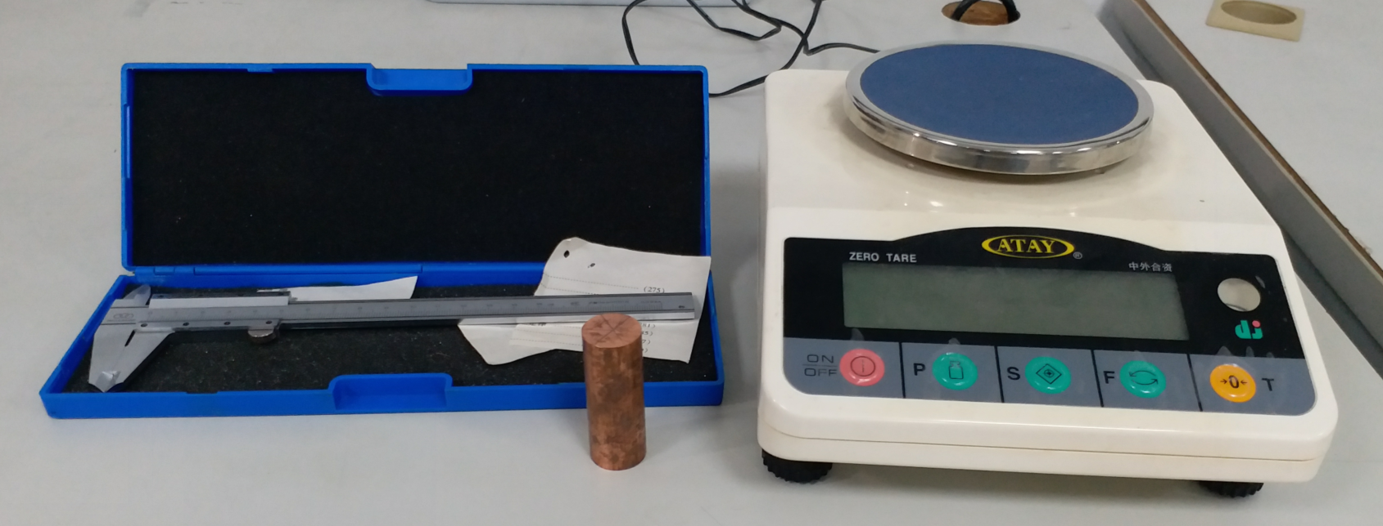
Procedure: Density of metal
Measure the density of the metallic cylinders by weighing them in air and measuring their volume.
Equipmennt：
An Electronic Balance ，a vernier Caliper， a small metallic cylinder

Slide 14
Measure the volume of the metallic cylinder.
Measure the diameter and height of the metallic cylinder 6 times each.
D
Calculate the volume of the cylinder
h

Slide 15
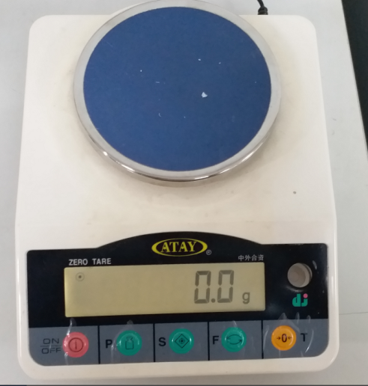
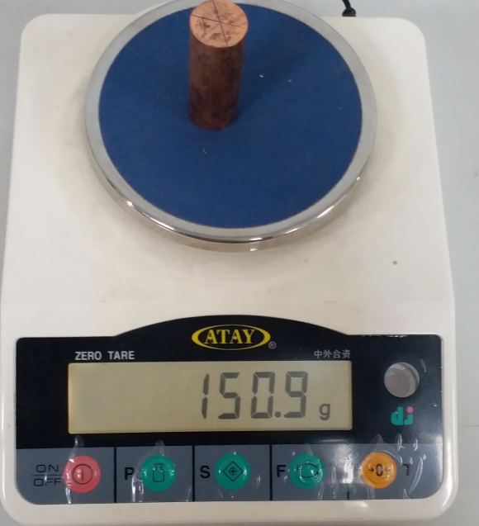
Measure the mass of metallic cylinder
Press the “on/off” switch and wait till “0.0g” is displayed .
Place the object on the pan and wait for the screen to settle on the correct mass.

Slide 16
Density of metal
By comparing the densities you measure with those listed in the Tables , try to identify the metal.
Metal | Density（ ） | Color
Alumium | 2.70 | Silvery-white
Titanium | 4.51 | Silver
Zinc | 7.13 | Blue-silvery
Iron | 7.87 | Silvery gray
Brass | 8.5-8.8 | yellow
Nickel | 8.91 | Silvery-white
Copper | 8.96 | Pinkish-orange

